Slide 1
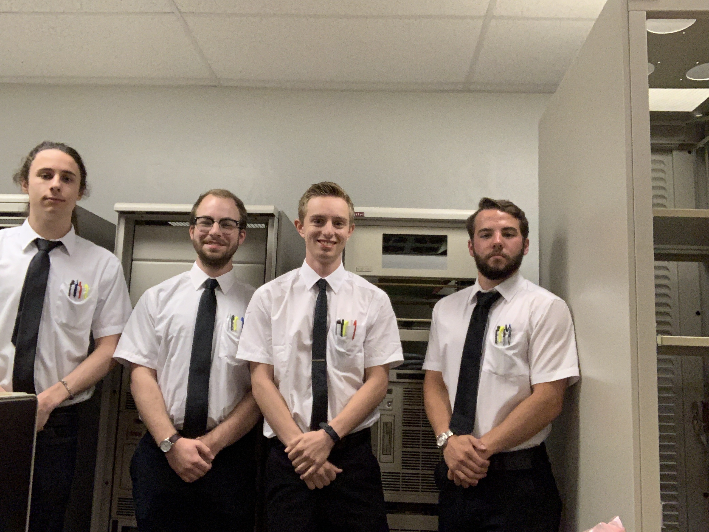
Nasa mission control: day3
Squad leaders: Chance
Co-pilots: Zach

Slide 2
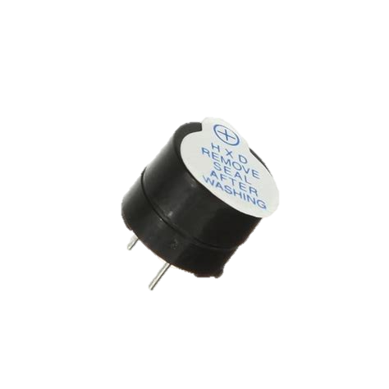
Buzzers
BUZZERS EMIT A STEADY HARDWARE-DEFINED FREQUENCY
ACTIVE BUZZERS
WORK WITH A DC SIGNAL
PASSIVE BUZZERS
WORK WITH AN AC SIGNAL
Notes:
Mention Piezoelectricity if you want. Ask about what we are using, mention AC and DC current.

Slide 3
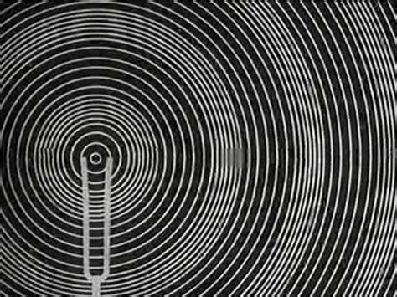
Sound
THE DECIBEL IS TYPICALLY USED AS A MEASURE OF INTENSITY
THE HERTZ IS USED AS A MEASURE OF SOUND FREQUENCY
Notes:
Doppler effect, dB are an analog to voltage because they are both referential, units of Hertz

Slide 4
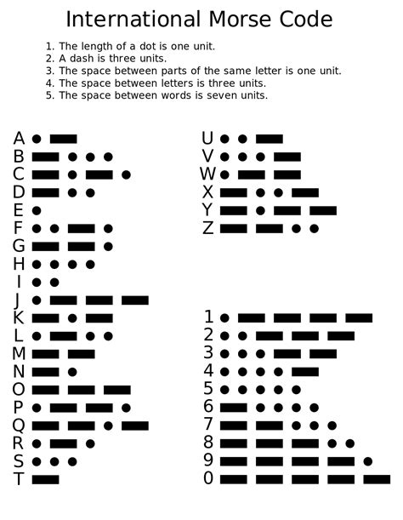
Morse code
IN YOUR GROUPS, TELL EACH OTHER YOUR FAVORITE COLOR IN MORSE CODE.

Slide 5
Using sftp to get base code AND LIBRARY
OPEN A COMMAND TERMINAL
sftp MY_PI’S_IP_ADDRESS
“raspberry”
cd /home/pi/Documents
get MorseCode_Skeleton /home/pi/Documents/Week1_AM_YOUR_TEAM
get MorseCode_Library /home/pi/Documents/Week1_AM_YOUR_TEAM
exit
cd /home/pi/Documents/Week1_AM_YOUR_TEAM
idle MorseCode_Skeleton

Slide 6
Python library
OPEN THE LIBRARY
Idle MorseCode_Library
THIS PYTHON LIBRARY TANSLATES ENGLISH INTO MORSE CODE
THE LIBRARY ALSO DEFINES SEVERAL FUNCTIONS TO HELP ABSTRACT YOUR CODE
Notes:
Walk through the library on the projector with them

Slide 7

URL: KAHOOT.IT
Notes:
Day 3: Sound, Buzzers, Libraries

Slide 8
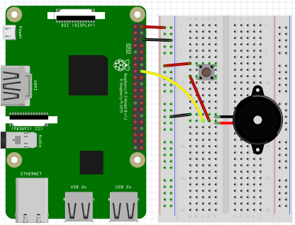
circuit
Notes:
Help them make the circuit

Slide 9
Python setup: we will need these lines of code
GET THE LIBRARY
DEFINE PINMODE
PIN SETUP
INITIALIZING PINS AND DECLARING PINMODES
Is this going to be an OUTPUT or an INPUT pin?

Slide 10
Possible functions
GPIO.setup(pin, Mode)
GPIO.setmode(GPIO.BCM)
MorseCode(pin)
GPIO.cleanup()
input()
print()
.Speak(message)
.upper()
Notes:
Have them write the code using the skeleton code, walk around and help.

Slide 11
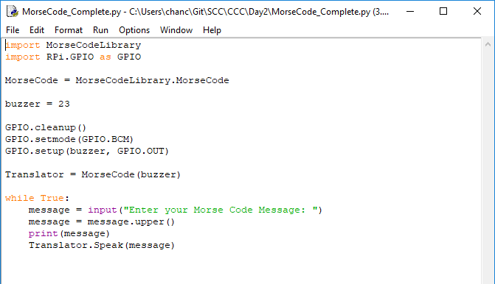
Optimized CODE
Notes:
Run through this with them. Ask about ways to simplify the code.

Slide 12
URL: KAHOOT.IT
Notes:
Day 3: Final Kahoot

